Slide 1
Thopson NFA
Presenter: Yuen-Shuo Li
Date: 2014/5/7
Department of Computer Science and Information Engineering
National Cheng Kung University, Taiwan R.O.C.
Notes:
1

Slide 2
Introduction
A regular expression (regex or regexp for short) is a special text string for describing a search pattern.

Slide 3
Introduction
Regular expression grammar
Syntax | Example
Any character except[\^$.|?*+() | a matches a
. | . matches x or (almost) any other character
| | (abc|def|xyz) matches abc, defor xyz
* | “ab*c" matches “ac“, “abc“, “abbc”, “abbbc”, ...
+ | “a+" matches “a“, “aa“, “aaa”, “aaa”, ...
? | abc? matches abc or ab
[] | [abc] matches a, b or c
{n} | a{3} matches aaa
{n,m} | {n,m} where n >= 0 and m >= n

Slide 4
Introduction
In automata theory, a nondeterministic finite automaton (NFA), or nondeterministic finite state machine, is a finite state machine that
does not require input symbols for state transitions
is capable of transitioning to zero or two or more states for a given start state and input symbol.
a
ε
ε
a

Slide 5
Introduction
Thompson's Construction Algorithm (TCA) derives a nondeterministic finite automaton (NFA) from any regular expression by splitting it into its constituent subexpressions, from which the NFA will be constructed using a set of rules.

Slide 6
The expression ε is converted to
ε
e.g. A? => (A|ε)

Slide 7
A symbol a of the input alphabet is converted to
a

Slide 8
The union expression RE1|RE2 is converted to
RE1
ε
ε
ε
ε
RE2
a

Slide 9
The concatenation expression RE1．RE2 is converted to
RE1
RE2
a

Slide 10
The concatenation expression RE1．RE2 is converted to
RE1
RE2
a
or

Slide 11
The Kleene star expression RE* is converted to
ε
RE
ε
ε
ε

Slide 12
(AB|CD)E*
A

Slide 13
(AB|CD)E*
A
B

Slide 14
(AB|CD)E*
A
B
A
B

Slide 15
(AB|CD)E*
A
B

Slide 16
(AB|CD)E*
A
B
C
D

Slide 17
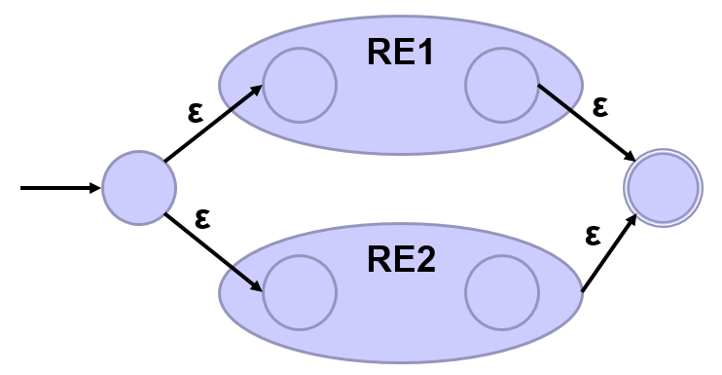
(AB|CD)E*
A
B
ε
ε
ε
ε
C
D

Slide 18
(AB|CD)E*
ε
A
B
ε
ε
ε
C
D

Slide 19
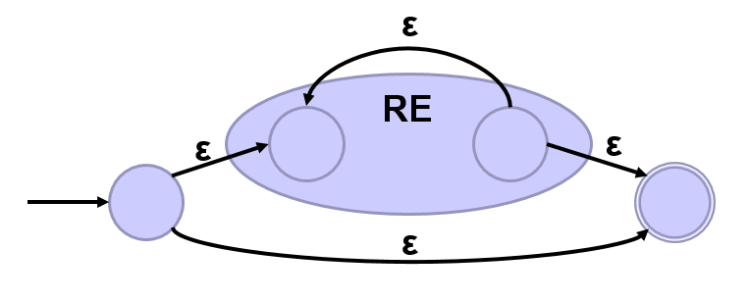
(AB|CD)E*
ε
A
B
ε
ε
ε
C
D
ε
E
ε
ε
ε

Slide 20
(AB|CD)E*
ε
ε
A
B
ε
ε
E
ε
ε
ε
C
D
ε

Slide 21
．
｜ *
． ．
Ａ Ｂ Ｃ Ｄ Ｅ
(AB|CD) E*
Regex
Parse Tree
NFA
Notes:
眼看很簡單，但電腦沒這麼厲害，所以必須找出方法，因此我們需要建 parse tree

Slide 22
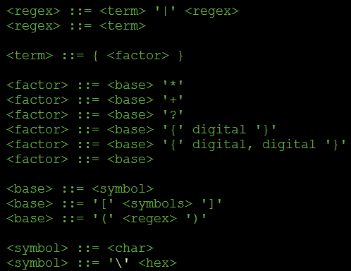
．
｜ *
． ．
Ａ Ｂ Ｃ Ｄ Ｅ
http://matt.might.net/articles/parsing-regex-with-recursive-descent/

Slide 23
．
｜ *
． ．
Ａ Ｂ Ｃ Ｄ Ｅ
Notes:
有了 parse tree 後，就可以……

Slide 24
．
｜ *
． ．
Ａ Ｂ Ｃ Ｄ Ｅ
A

Slide 25
．
｜ *
． ．
Ａ Ｂ Ｃ Ｄ Ｅ
AB

Slide 26
．
｜ *
． ．
Ａ Ｂ Ｃ Ｄ Ｅ
AB．

Slide 27
．
｜ *
． ．
Ａ Ｂ Ｃ Ｄ Ｅ
AB．C

Slide 28
．
｜ *
． ．
Ａ Ｂ Ｃ Ｄ Ｅ
AB．CD

Slide 29
．
｜ *
． ．
Ａ Ｂ Ｃ Ｄ Ｅ
AB．CD．

Slide 30
．
｜ *
． ．
Ａ Ｂ Ｃ Ｄ Ｅ
AB．CD．|

Slide 31
．
｜ *
． ．
Ａ Ｂ Ｃ Ｄ Ｅ
AB．CD．|E

Slide 32
．
｜ *
． ．
Ａ Ｂ Ｃ Ｄ Ｅ
AB．CD．|E*

Slide 33
．
｜ *
． ．
Ａ Ｂ Ｃ Ｄ Ｅ
AB．CD．|E*．

Slide 34
．
｜ *
． ．
Ａ Ｂ Ｃ Ｄ Ｅ
AB．CD．|E* ．
postfix notation
Notes:
這個順序即是後序，網路上有些簡單版本的 regex tool 就直接用後序的方式取代建成 parse tree。

Slide 35
AB．CD．|E* ．

Slide 36
AB．CD．|E* ．
stack
Notes:
有了 parse tree(or 後序) 後……

Slide 37
B．CD．|E* ．
A
stack

Slide 38
B．CD．|E* ．
A
A
stack

Slide 39
B．CD．|E* ．
A
stack

Slide 40
．CD．|E* ．
B
A
stack

Slide 41
．CD．|E* ．
B
B
A
stack

Slide 42
．CD．|E* ．
B
A
stack

Slide 43
CD．|E* ．
B
．
A
stack

Slide 44
CD．|E* ．
．
B
A
stack

Slide 45
CD．|E* ．
A
．
B
stack

Slide 46
CD．|E* ．
A
B
stack

Slide 47
CD．|E* ．
B
A
stack

Slide 48
D．|E* ．
C
B
A
stack

Slide 49
D．|E* ．
C
C
B
A
stack

Slide 50
D．|E* ．
C
B
A
stack

Slide 51
．|E* ．
D
D
C
B
A
stack

Slide 52
．|E* ．
D
C
A
B
stack

Slide 53
|E* ．
．
D
C
A
B
stack

Slide 54
|E* ．
．
D
C
A
B
stack

Slide 55
|E* ．
C
．
D
A
B
stack

Slide 56
|E* ．
C
D
A
B
stack

Slide 57
|E* ．
C
D
A
B
stack

Slide 58
E* ．
|
C
D
A
B
stack

Slide 59
E* ．
|
C
D
A
B
stack

Slide 60
E* ．
A
B
|
C
D
stack

Slide 61
E* ．
ε
A
B
ε
ε
ε
C
D
stack

Slide 62
E* ．
ε
ε
ε
A
B
ε
C
D
stack

Slide 63
* ．
E
ε
ε
ε
A
B
ε
C
D
stack

Slide 64
* ．
E
E
ε
ε
ε
A
B
ε
C
D
stack

Slide 65
* ．
E
ε
ε
ε
A
B
ε
C
D
stack

Slide 66
．
E
*
ε
ε
ε
A
B
ε
C
D
stack

Slide 67
．
E
*
ε
ε
ε
A
B
ε
C
D
stack

Slide 68
ε
．
E
ε
ε
*
ε
ε
ε
ε
A
B
ε
C
D
stack

Slide 69
．
ε
E
ε
ε
*
ε
ε
ε
ε
A
B
ε
C
D
stack

Slide 70
ε
ε
A
B
ε
ε
E
ε
ε
ε
C
D
ε

Slide 71
Regular Expression to NFA DFA
http://hackingoff.com/compilers/regular-expression-to-nfa-dfa

